Slide 1
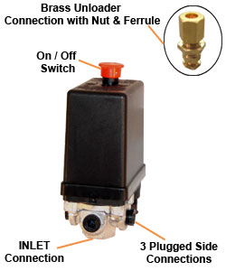
NEMA Italian Pressure Switch - “Single Phase”
Bar | PSI | Code
11 | 160 | NE-AZ8600
- maximum AMPS 20A
- maximum Volts 380V
- unloader port
- non adjustable differential
- on-off switch
- 1/4" BSP inlet
- IP42 protection rating

